Slide 1


Develop and release kubectl who-can plugin
Daniel Pacak
OOS Engineer with Aqua Security
Maintainer of Harbor - CNCF project

Slide 2
Agenda
kubectl plugins & krew
Kubernetes RBAC
kubectl who-can plugin
Fake *Clientset & ReactionFunc
testify mock.Mock
In-process integration test
Code coverage with codecov.io
Release with GoReleaser

Slide 3
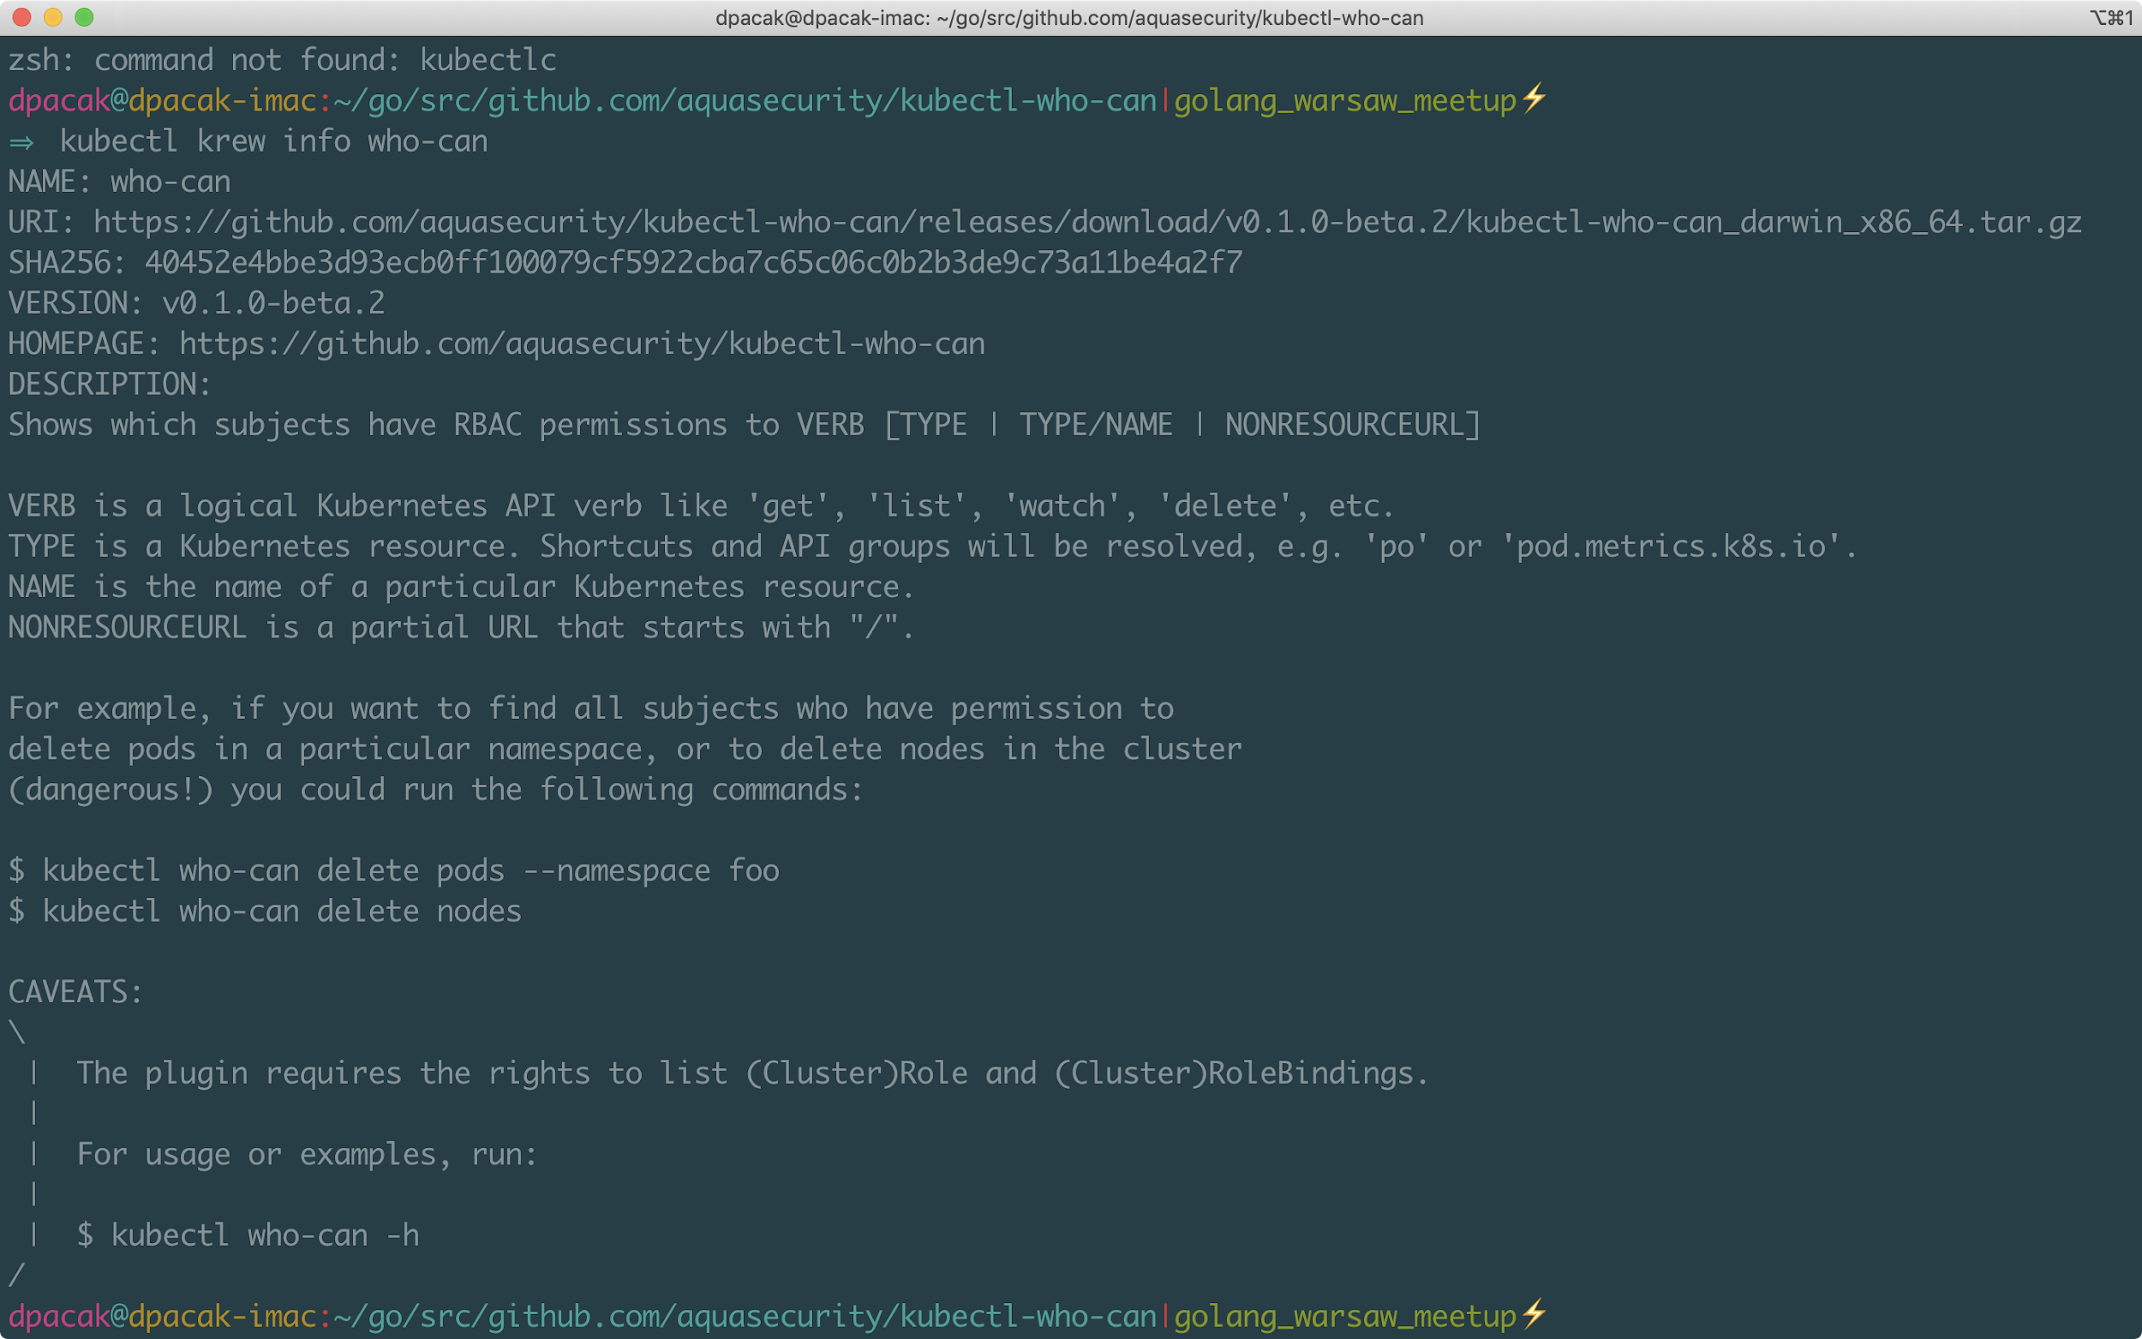
kubectl plugins & krew

Slide 4
Kubernetes RBAC
Role-based access control is a method of regulating access to (K8S) resources through API server based on the roles assigned to subjects​
Can <subject> <verb> <resource> ?​
Can <subject> <verb> <resource> in <namespace> ?​
Can <Bob> <create> <deployments> in <myapp> namespace?​

Slide 5
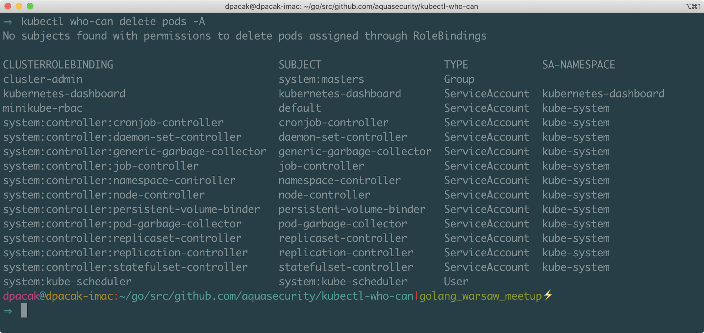
kubectl who-can plugin

Slide 6
kubectl who-can plugin architecture
AccessChecker
NamespaceValidator
NamespaceValidatorTest
who-can
ResourceResolver
PolicyRuleMatcher

Slide 7
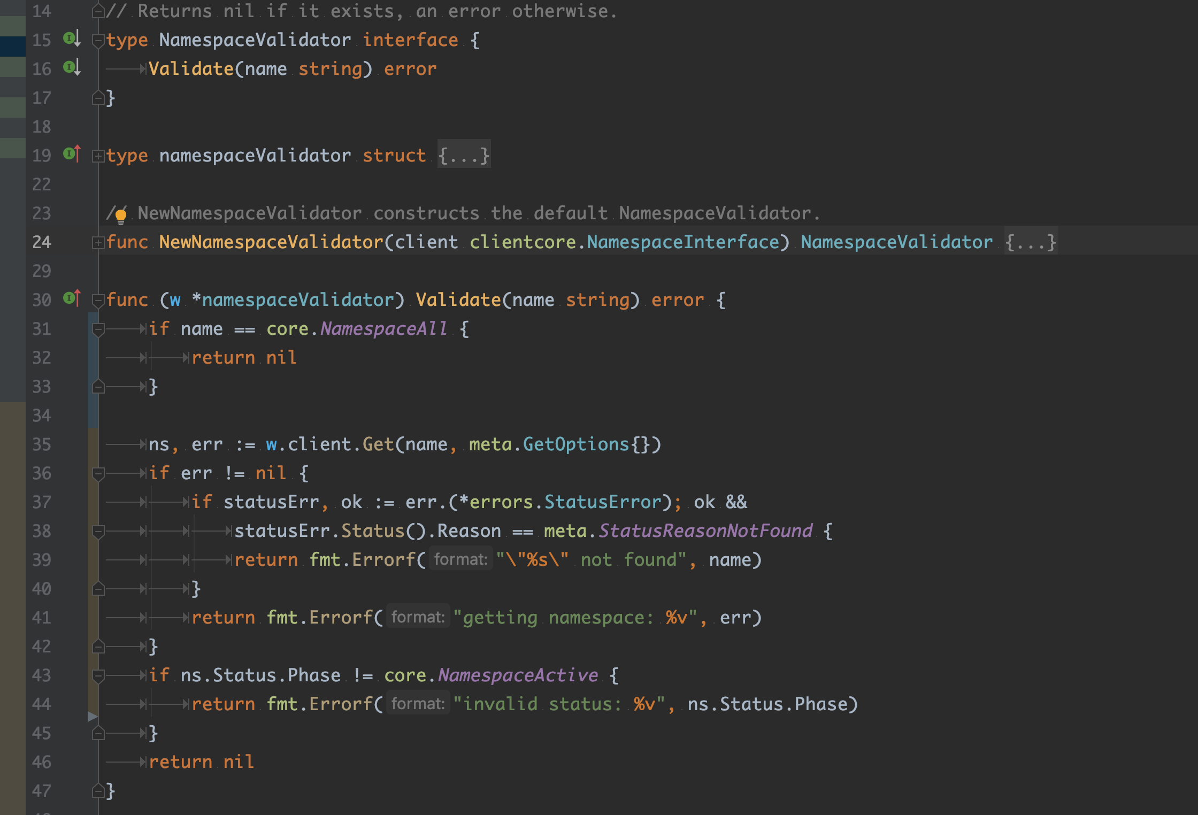
NamespaceValidator

Slide 8
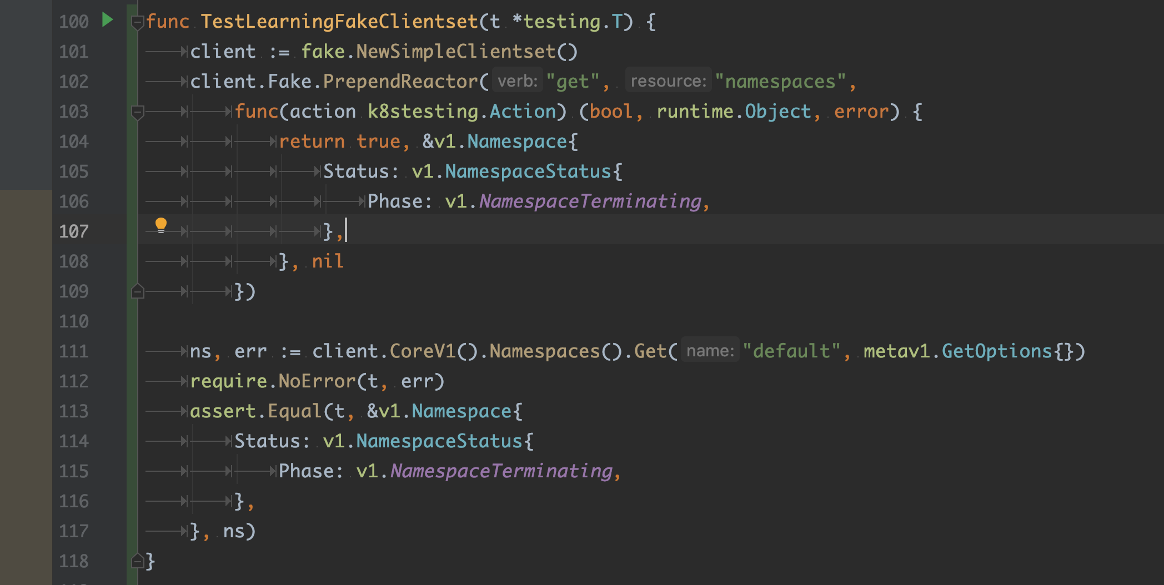
Fake *Clientset & ReactionFunc

Slide 9
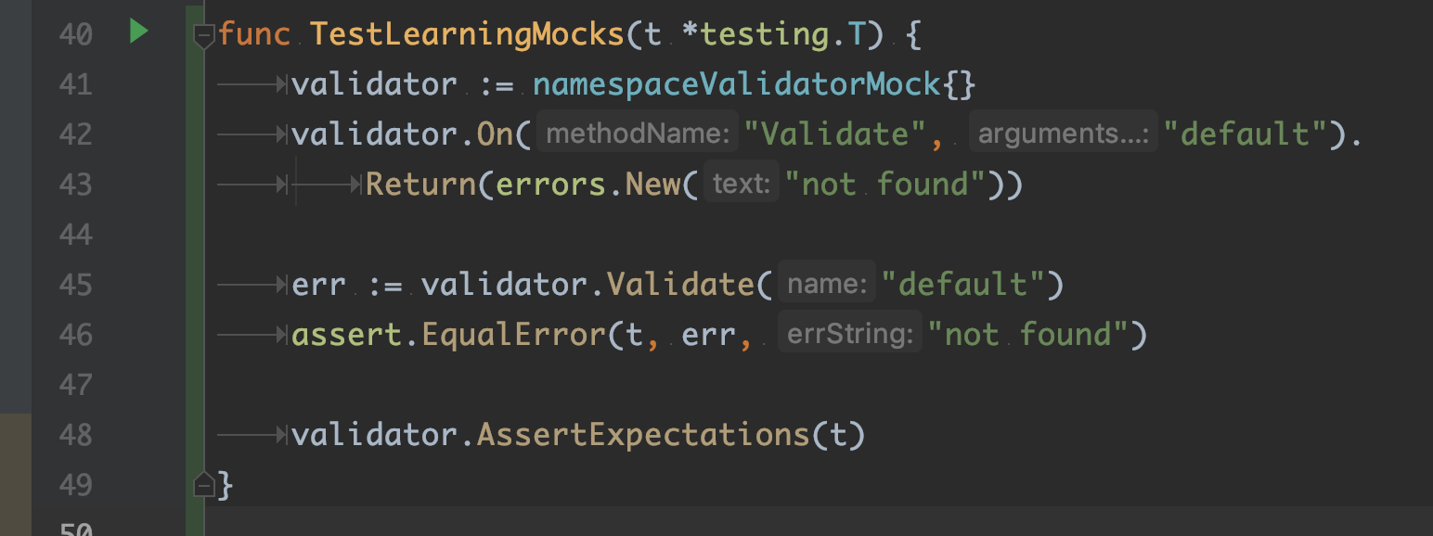
testify mock.Mock

Slide 10
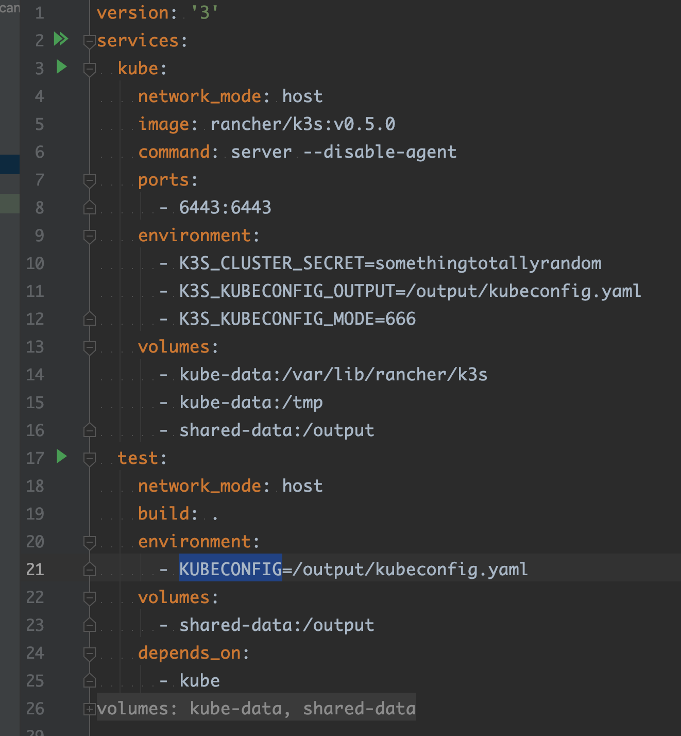
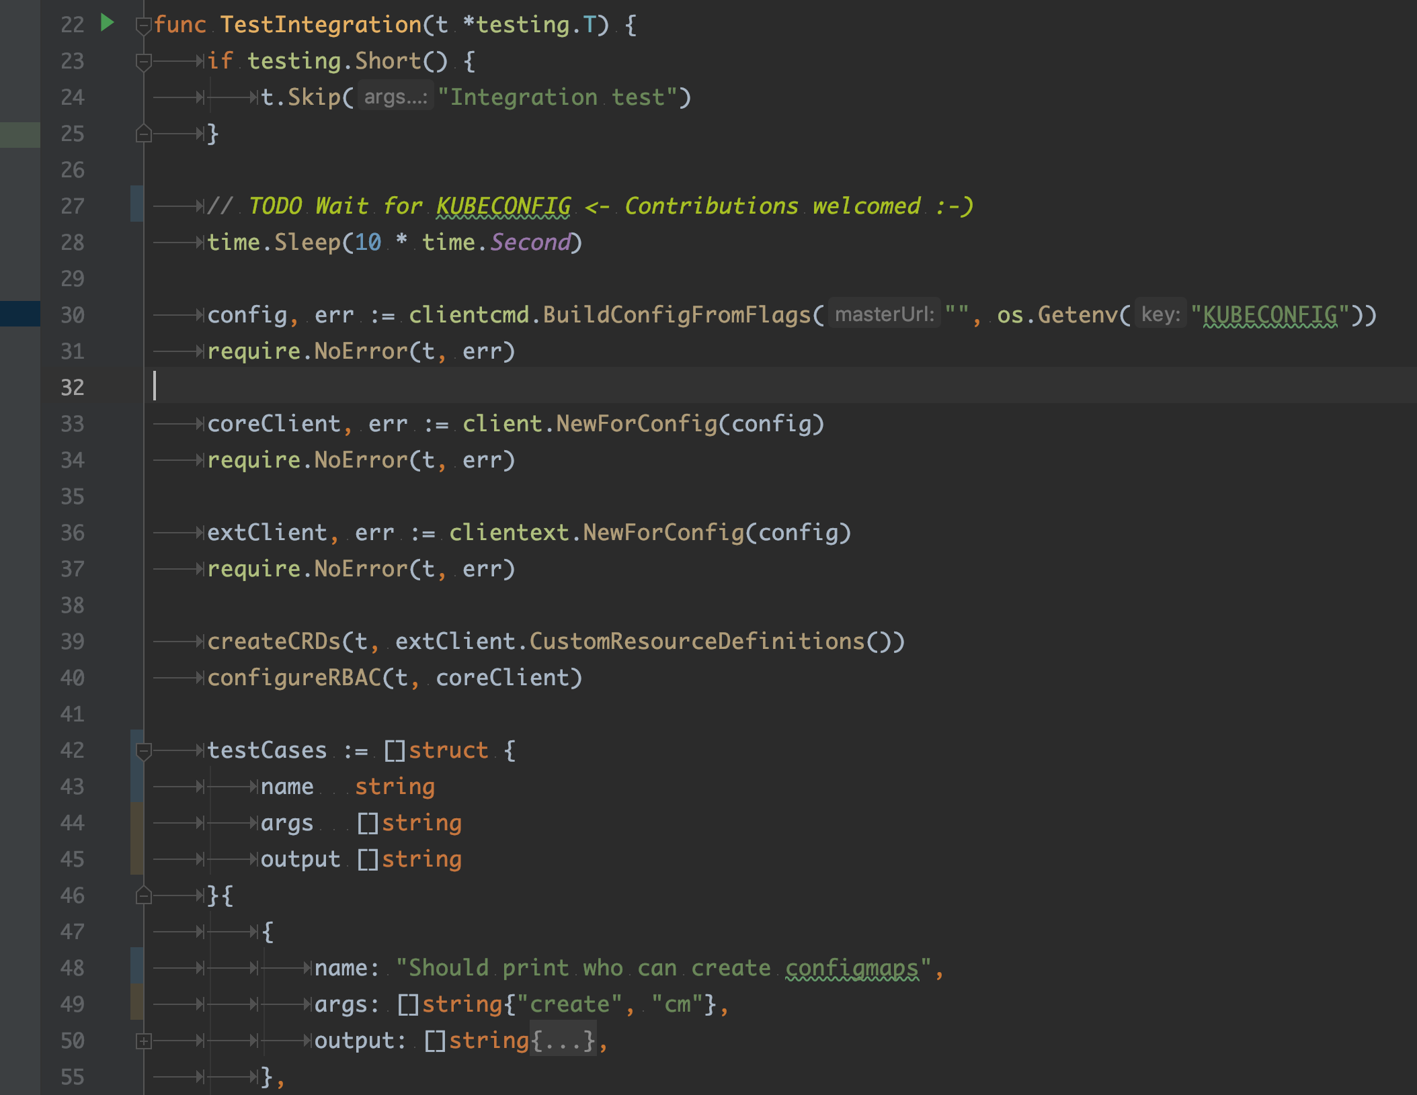
In-process integration test

Slide 11
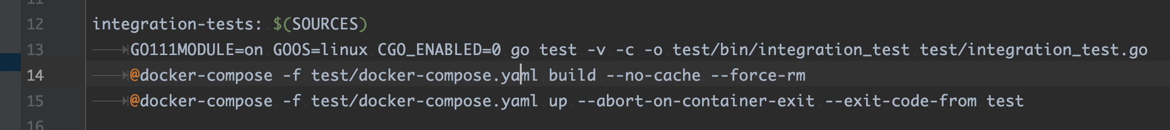
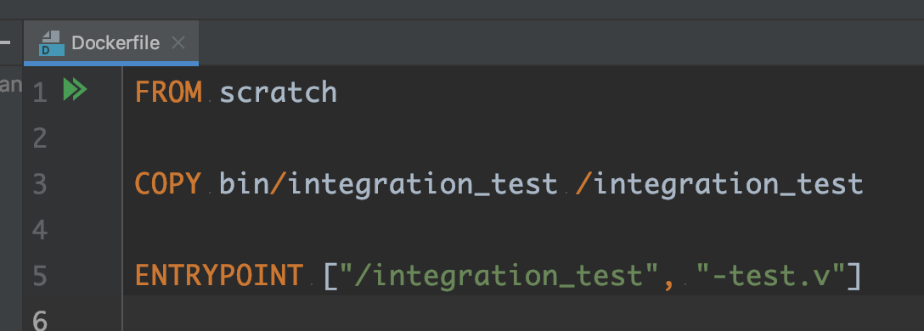
In-process integration test

Slide 12
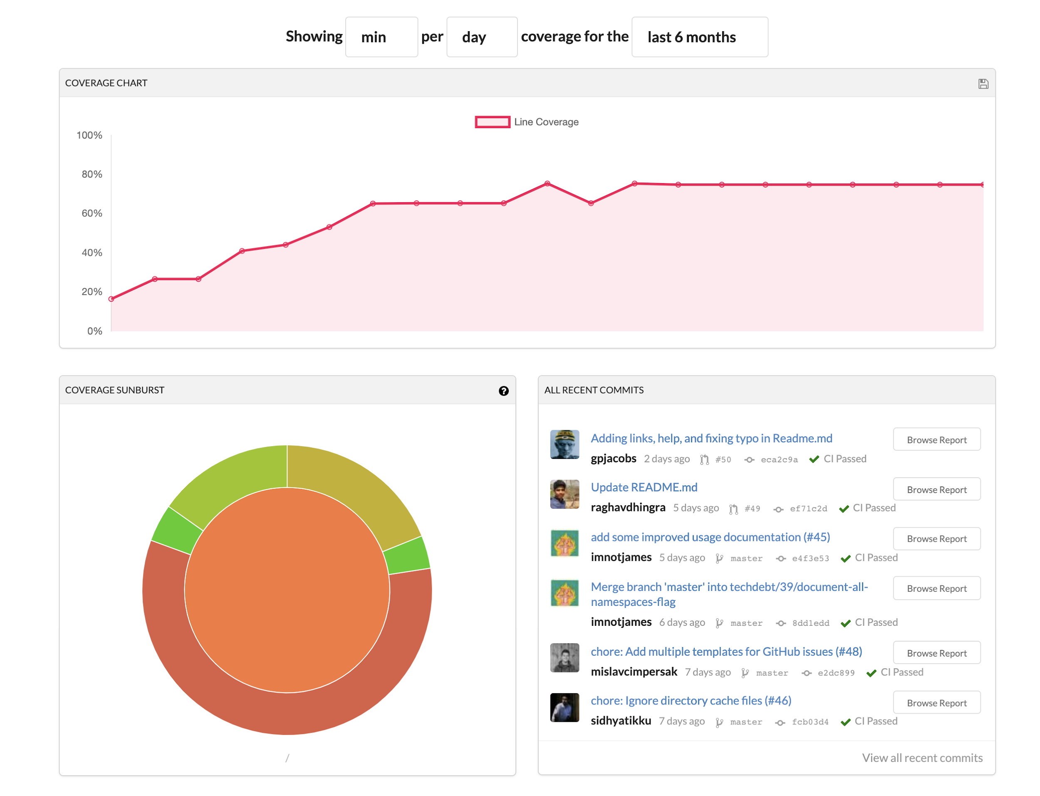

Code coverage with codecov.io

Slide 13
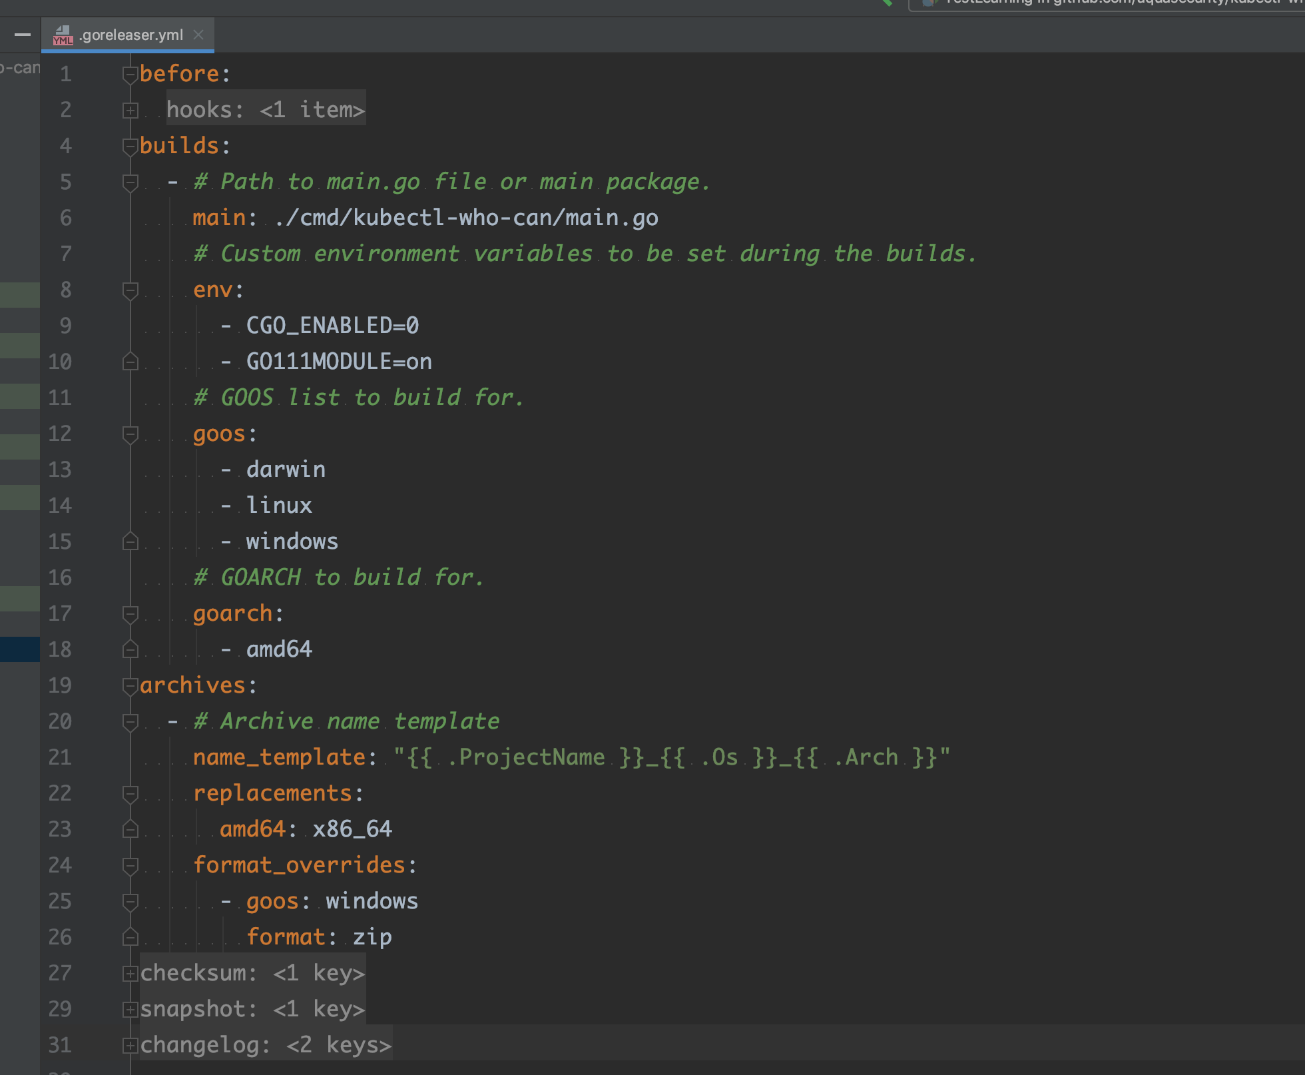
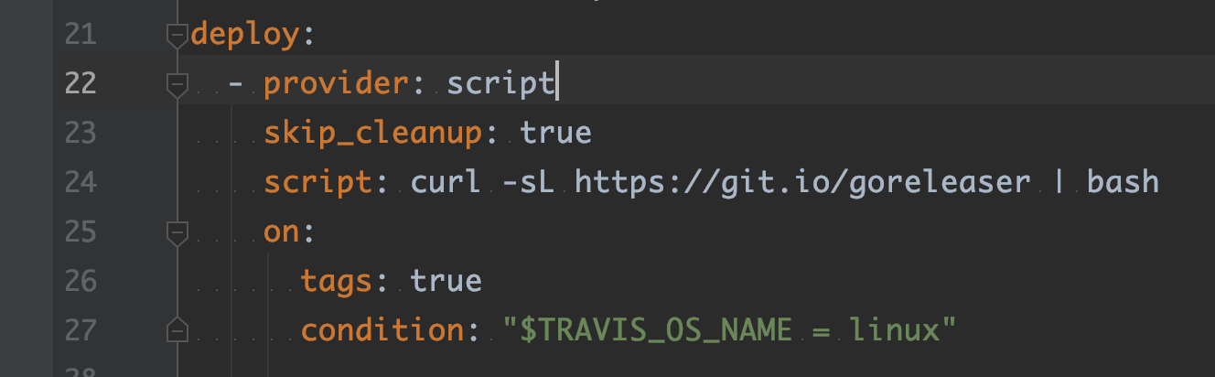
Releases with GoReleaser

Slide 14
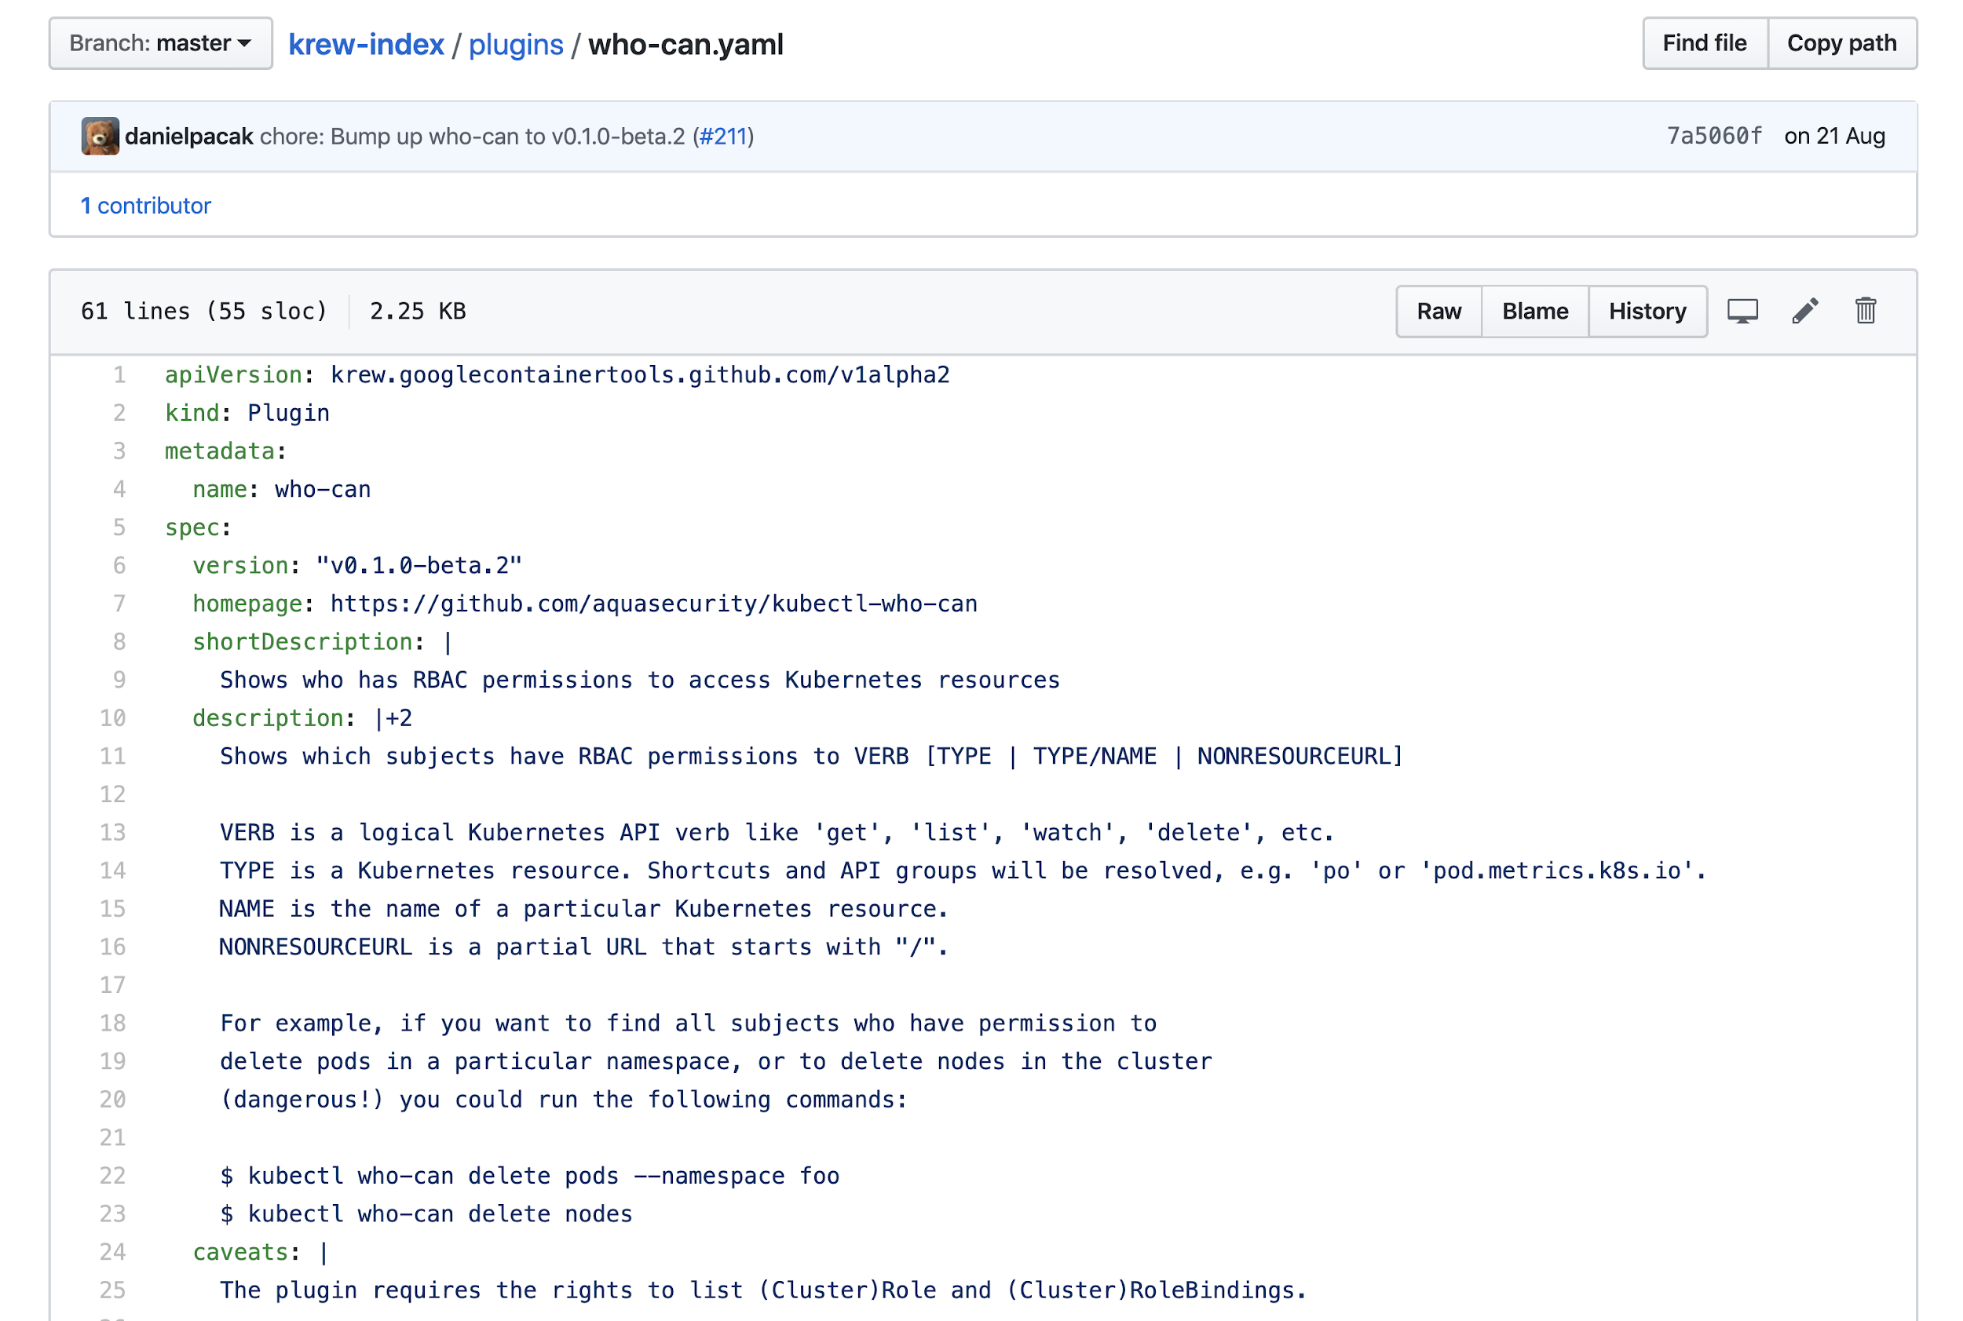
Updating krew-index

Slide 15
Thank you!
https://github.com/aquasecurity/kubectl-who-can

